Slide 1
Capstone project

Slide 2
Introduction
I chose analysis of coffee shops in toronto as theme of my report. The coffee industry is becoming exceedingly popular in recent years. Even though the industry is dominated by world famous coffee corporation, small local coffee shops have their own special place. Since they offer more personal and sometimes unique experience they can become especially popular in the local community. It would be beneficial to open a new coffee shop somewhere away from existing chain shops. Small shops can’t compete with chain store prices and speed of service, and might simply lose customers to a more well known brand. Also it would not be a good idea to open a new shop near other local coffee shops. Competition with other small shops may add additional problems to already competitive industry.
Since the toronto coffee industry is still growing, the city is a good place to establish a new shop. In this report the analysis of the best neighbourhood will be concluded.

Slide 3
Data
Data from wikipedia on Canada postal codes to obtain information on districts of Toronto https://en.wikipedia.org/wiki/List_of_postal_codes_of_Canada:_M
Data on latitude and longitude of neighbourhoods from this dataset http://cocl.us/Geospatial_data
Foursquare data because you can absolutely use anything else, but you can’t, they are the sponsor to obtain information about coffee shops

Slide 4
Methodology
Data from wikipedia have been read into pandas dataframe. After that data was prepared for the analysis. Neighbourhoods with no borough assigned were removed from dataset. After that data was grouped by postal code and borough. Records with missing neighborhood name were assigned the same name as their borough. After that geodata have been read into pandas dataframe and merged with data from wikipedia. After that data on Toronto have been selected from the dataframe and put into separate dataframe. Using folium map of toronto was created. After that data about coffee shops for each neighbourhood has been obtained from !PRAISE THE GOD OF DATA! Foursquare !PRAISE THE GOD OF DATA! After obtaining the data it was merged with neighbourhood dataset and neighbourhood were put into separate bins based on number of coffee shops in the neighbourhood. After that information was printed as a table and visualized on folium map.

Slide 5
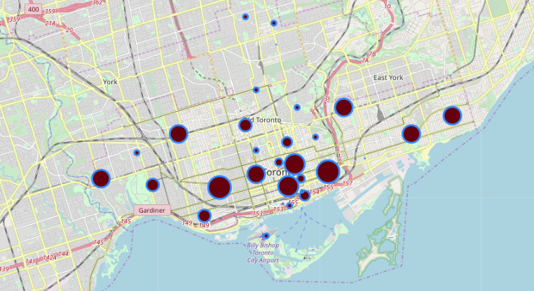

Slide 6
FIN
Sponsored by Foursquare and peer-grading hate

